Slide 1

Mathematics for Programming

Slide 2
Recap
Floor vs Ceiling
Counting number of divisors
Improving our method
Prime number check
Sieve of Eratosthenes
Digit extraction

Slide 3

GCD - Greatest Common Divisor
গ.সা..গুঃ গরিষ্ঠ সাধারণ গুণনীয়ক
Divisor
Common divisor
Greatest common divisor
Example: Find the gcd of $15$ and $6$
Divisors of $15: 1,3,5,15$
Divisors of $6: 1,2,3,6$
Common divisors: $1,3$
GCD: $3$
Co-prime: If $gcd⁡(a,b)=1$, $a$ and $b$ are co-prime.
Example: $8$ and $15$

Slide 4
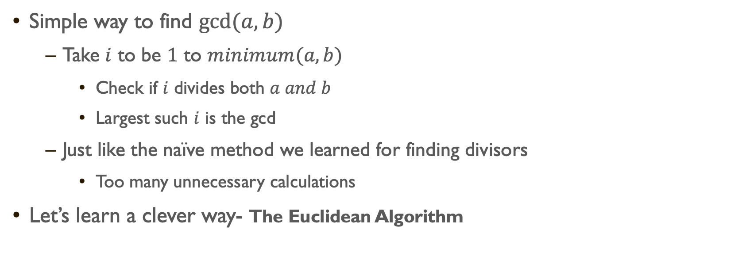
GCD – How to calculate?
Simple way to find $gcd⁡(a,b)$
Take $i$ to be $1$ to $minimum(a,b)$
Check if $i$ divides both $a and b$
Largest such $i$ is the gcd
Just like the naïve method we learned for finding divisors
Too many unnecessary calculations
Let’s learn a clever way- The Euclidean Algorithm

Slide 5
GCD – The Euclidean Algorithm

Slide 6
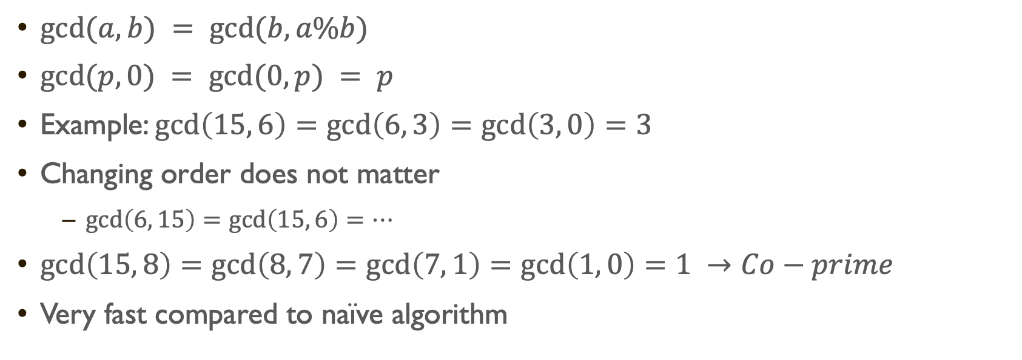
GCD – The Euclidean Algorithm
$gcd⁡(a, b) = gcd⁡(b, a\%b)$
$gcd⁡(p,0) = gcd⁡(0,p) = p$
Example: $\gcd\left(15, 6\right)=\gcd\left(6, 3\right)=\gcd\left(3, 0\right)=3$
Changing order does not matter
$\gcd\left(6, 15\right)=\gcd\left(15, 6\right)=…$
$\gcd\left(15, 8\right)=\gcd\left(8, 7\right)=\gcd\left(7, 1\right)=\gcd\left(1, 0\right)=1 →Co−prime$
Very fast compared to naïve algorithm

Slide 7
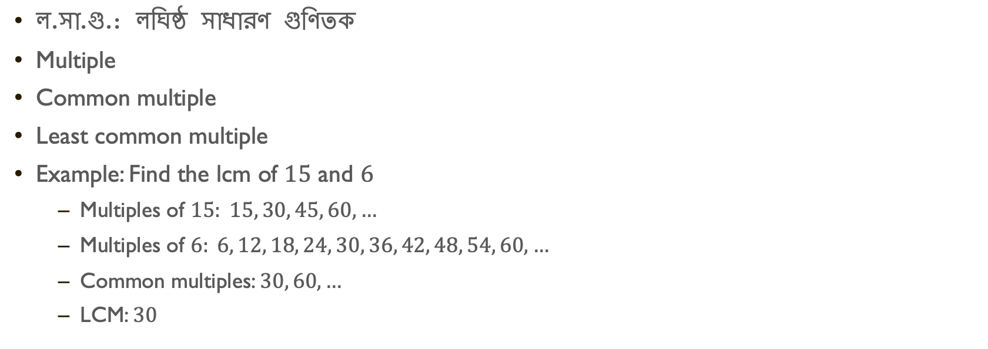
LCM - Least common multiple
ল.সা.গু.: লঘিষ্ঠ সাধারণ গুণিতক
Multiple
Common multiple
Least common multiple
Example: Find the lcm of $15$ and $6$
Multiples of $15: 15, 30, 45, 60, …$
Multiples of $6: 6, 12, 18, 24, 30, 36, 42, 48, 54, 60, …$
Common multiples: $30, 60, …$
LCM: $30$

Slide 8
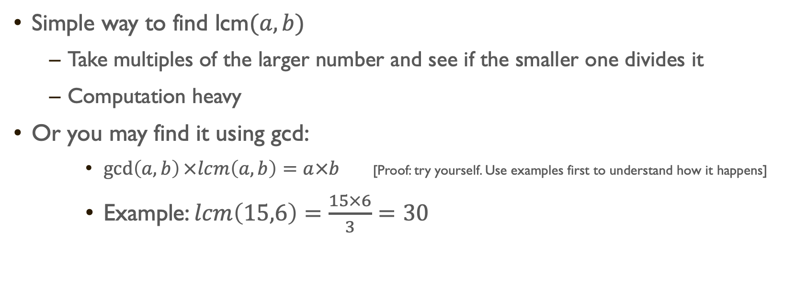
LCM – How to calculate?
Simple way to find lcm$⁡(a,b)$
Take multiples of the larger number and see if the smaller one divides it
Computation heavy
Or you may find it using gcd:
$\gcd\left(a,b\right)×lcm\left(a,b\right)=a×b$ [Proof: try yourself. Use examples first to understand how it happens]
Example: $lcm\left(15,6\right)=\frac{15×6}{3}=30$

Slide 9
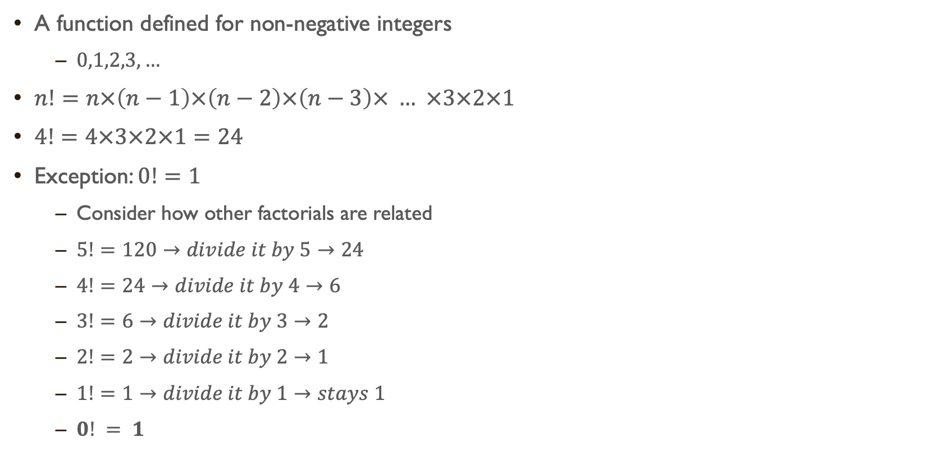
Factorial
A function defined for non-negative integers
$0,1,2,3,…$
$n!=n×\left(n−1\right)×\left(n−2\right)×\left(n−3\right)× … ×3×2×1$
$4!=4×3×2×1=24$
Exception: $0!=1$
Consider how other factorials are related
$5!=120→divide it by 5→24$
$4!=24→divide it by 4→6$
$3!=6→divide it by 3→2$
$2!=2→divide it by 2→1$
$1!=1→divide it by 1→stays 1$
$0! = 1$

Slide 10

Factorial – why?
Consider a cricket team with $11$ players
How many batting orders are possible?
What if we had 2 players?
Answer: 2
AB or BA
What about 3 players?
Answer: 6
ABC, ACB, BAC, BCA, CAB, CBA

Slide 11












Factorial – why?
Now go for $11$ players
$11 ×10×…×1=11!$
These type of problems are part of "Combinatorics”
A branch of mathematics
Deals with permutation and combination
More later
$$11$$
$$10$$
$$9$$
$$8$$
$$7$$
$$6$$
$$5$$
$$4$$
$$3$$
$$2$$
$$1$$

Slide 12
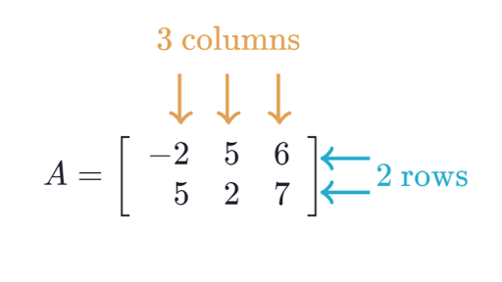

Intro to matrix/matrices
Collection of numbers
Arranged in rows and columns
$A_{i,j}= ?$
$A_{2,3}= ?$

Slide 13
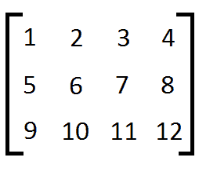
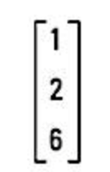
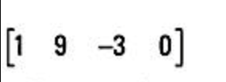
Intro to matrix/matrices
How many rows and columns in each of the following matrices?

Slide 14
Adding matrices
Why?
Let’s consider a matrix as an exam result table:
Rows indicate individual students (3 students)
Columns indicate subject (2 subjects)
40 | 36
28 | 32
30 | 27
19 | 35
48 | 12
33 | 48
59 | 71
76 | 44
63 | 75
Midterm
Final

Slide 15
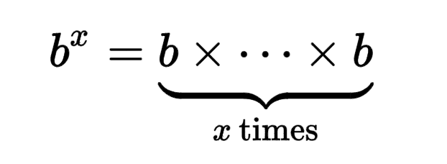

Power and roots
Power: $b^{x}$
Base and exponent
$5^{3}=5×5×5=125$

Slide 16

Power and roots
Root: $\sqrt[n]{a}$ ($n^{th}$root of $a$)
Assume: $\sqrt[n]{a}=x$
Then, $x^{n}=a$
$\sqrt[2]{16}=4$
$[4^{2}=16]$
$\sqrt[3]{27}=3$
$[3^{3}=27]$

Slide 17
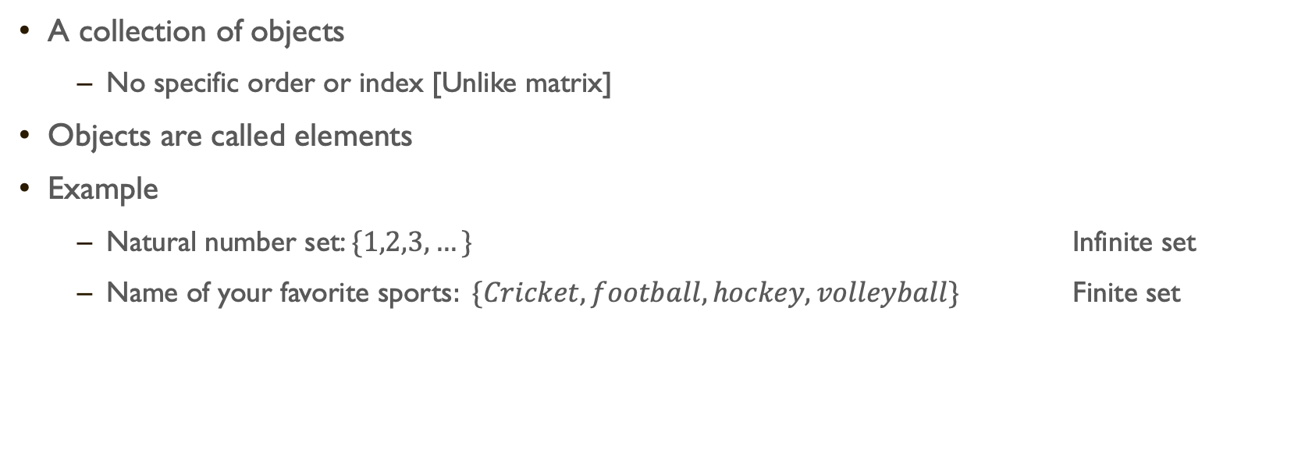
Intro to Sets
A collection of objects
No specific order or index [Unlike matrix]
Objects are called elements
Example
Natural number set: $\{1,2,3,…\}$ Infinite set
Name of your favorite sports$: \{Cricket, football, hockey, volleyball\}$ Finite set

Slide 18
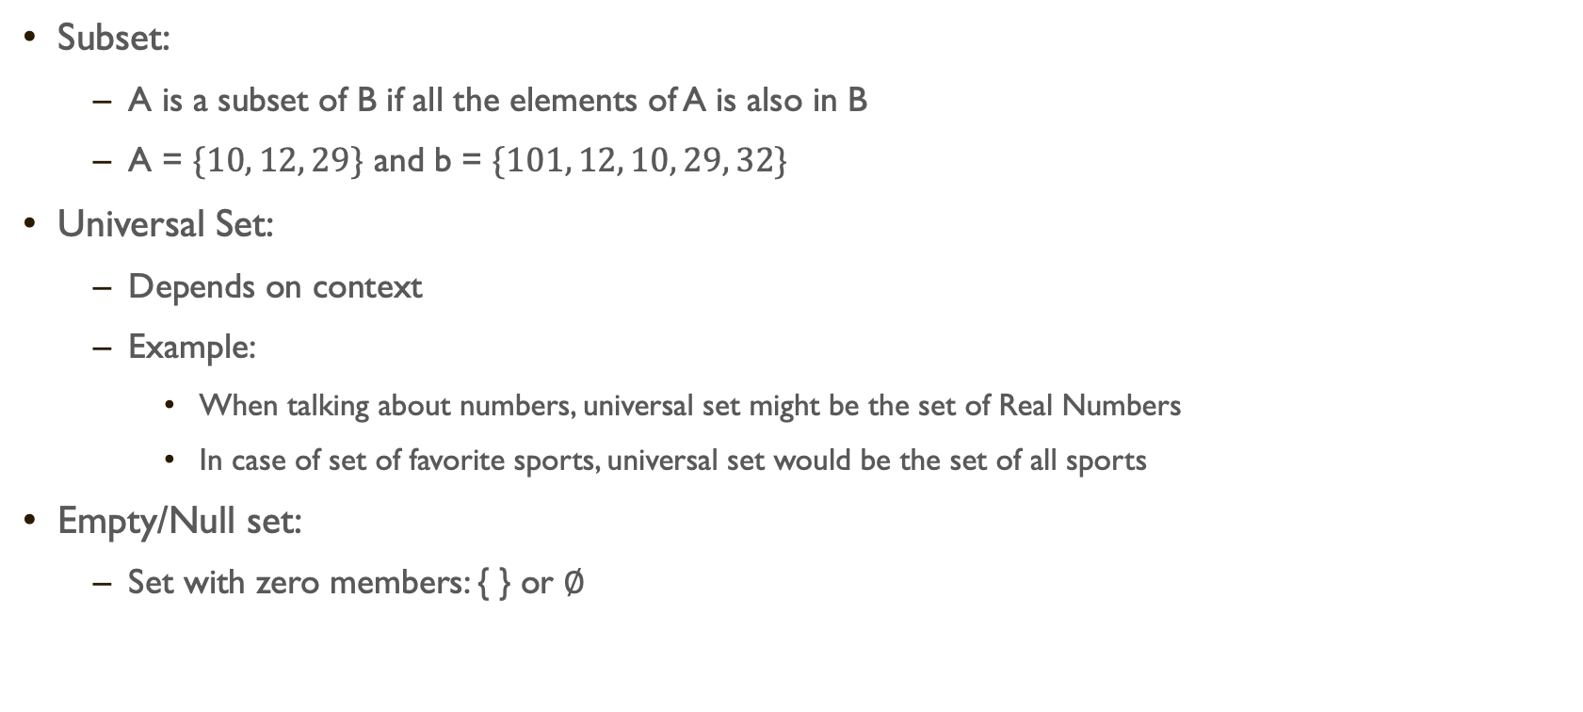
Intro to sets
Subset:
A is a subset of B if all the elements of A is also in B
A = $\{10, 12, 29\}$ and b = $\{101, 12, 10, 29, 32\}$
Universal Set:
Depends on context
Example:
When talking about numbers, universal set might be the set of Real Numbers
In case of set of favorite sports, universal set would be the set of all sports
Empty/Null set:
Set with zero members: { } or $∅$

Slide 19
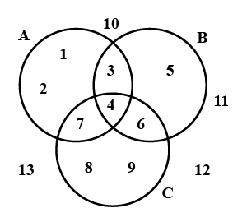

Intro to sets
$U = \{1,2,3,4,5,6,7,8,9,10,11,12,13\}$
$A= \{1,2,3,4,7\}$
$B = \left\{3,4,5,6\right\}$
$C = \left\{4,6,7,8,9\right\}$
Three set operations:
Union
Intersection
Complement

Slide 20
Summary
GCD and LCM
Euclidean algorithm for GCD (and LCM too)
Factorials and a combinatorial problem
Matrices and an application of them
Power and roots
Sets and set operations
See you after mid!

Slide 21
next

Slide 22
Practice Day

